Slide 1
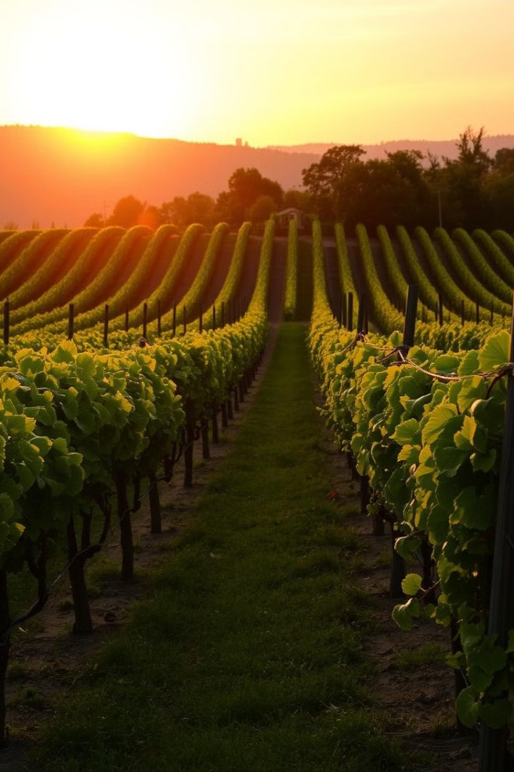
Predicting Wine Quality with Machine Learning
Explore machine learning techniques to predict wine quality. Discover key factors influencing taste. Learn about dataset analysis, model training, and performance evaluation.
by Harshitha Challa

Slide 2
Dataset Overview: Exploring Wine Attributes
Fixed Acidity
Volatile Acidity
Citric Acid
Acids contribute to wine's taste. The fixed acidity represents non-volatile acids.
Too much volatile acidity results in an unpleasant vinegar taste.
Citric acid enhances freshness. It supplements the flavor profile.

Slide 3
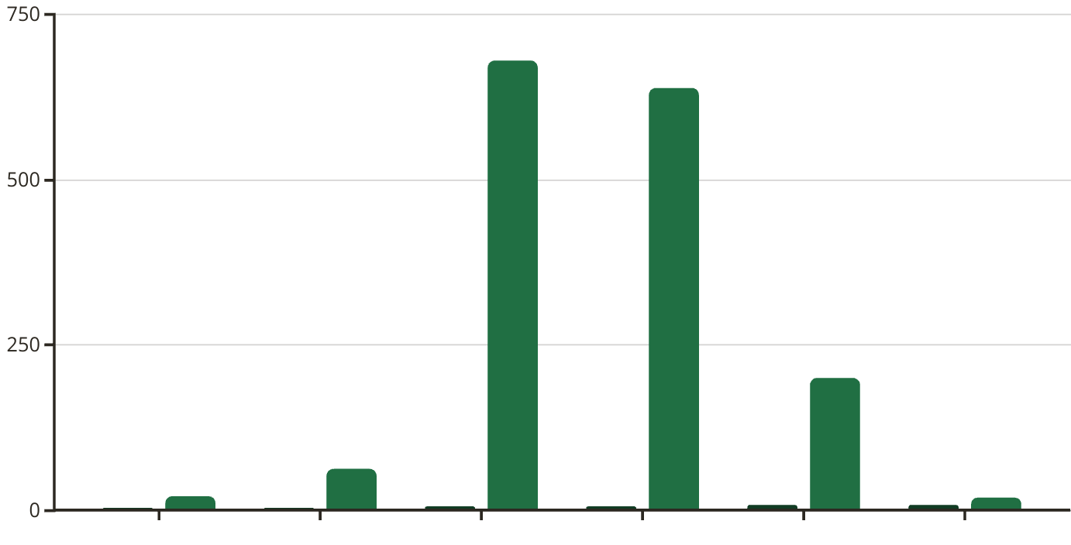
Understanding Wine Quality Distribution
Quality Score
Count
The bar plot shows the distribution of wine quality scores. Most wines fall in the range of 5 and 6.

Slide 4

Correlations: Unveiling Relationships in Wine Data
Positive Correlation
Negative Correlation
Higher alcohol content often correlates with better wine quality.
Increased volatile acidity tends to decrease perceived wine quality.
Complex Interactions
Some features have complex relationships, demanding advanced ML techniques.

Slide 5
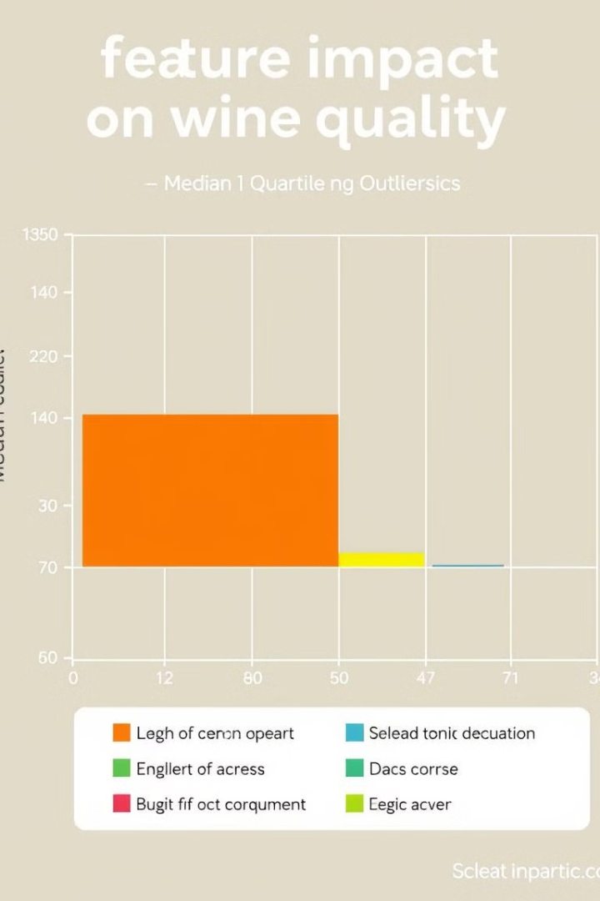



Key Feature Analysis: Impact on Wine Quality
Alcohol
Acidity
Sugar
Influences body and mouthfeel. Higher levels often indicate better quality.
Balances sweetness. Impacts wine's overall freshness and crispness.
Contributes to sweetness. Also affects the wine’s perceived body.

Slide 6
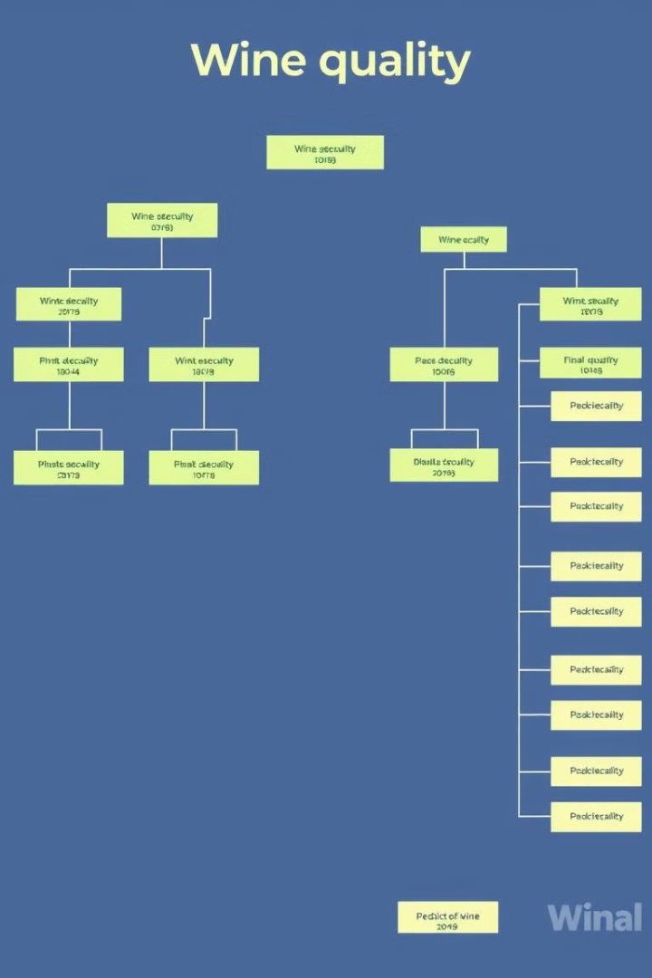
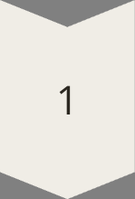
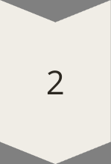
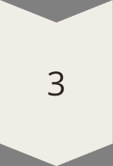
Model Training: Decision Tree for Wine Quality
Data Splitting
Divide data into training and testing sets. Ensures robust model evaluation.
Tree Building
Recursively split nodes based on feature importance. Creates decision rules.
Prediction
Classify wines. Assign quality scores based on tree structure.

Slide 7
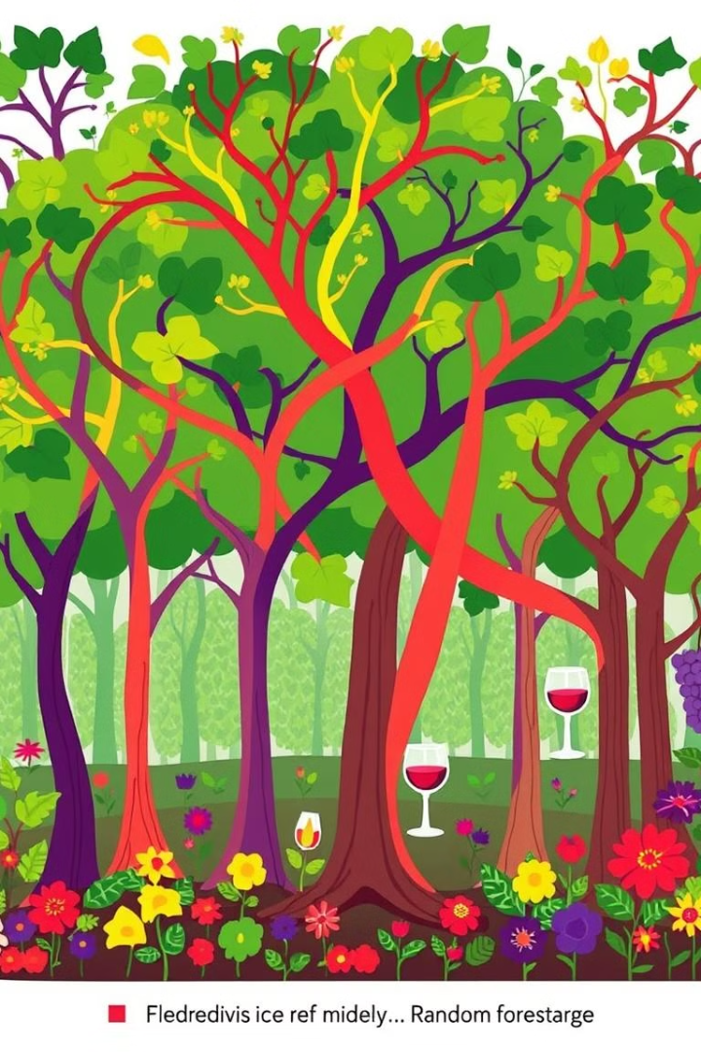
Model Training: Random Forest & Accuracy Comparison
Decision Tree
65%
Random Forest
72%
Random Forest outperforms Decision Tree. It provides better accuracy.

Slide 8

Conclusions & Insights: Improving Wine Quality
1
Key Factors
2
Model Performance
Alcohol content and acidity significantly impact wine scores.
Random Forest provides superior accuracy.
3
Future Steps
Optimize vineyards based on ML insights. Focus on key attributes.

